Slide 1


ITP 2021
Report from the Conference Chair
Daniele Gorla

Slide 2
Registrations: Provisional Incomes and Expenses
CATEGORY | NUM. | INCOME
ITP - Author Fee (1) | 17 | 2040
ITP - Non-Author Fee (3) | 22 | 660
ITP & LICS - Author Fee (2) | 14 | 1960
ITP & LICS - Non-Author Fee (4) | 8 | 200
Workshops Fees (Authors & Non-Authors) (5) | 13 | 390
ITP & Workshops – Non Author Fee (6) | 18 | 1080
Free registrations | 8 | 0
TOTAL INCOME | 100 | 6330
PROVISIONALS EXPENSES
Secretary | 4000
LIPICS | 1922,88
TOTAL | 5922,88
SURPLUS |  | 407,12

Slide 3
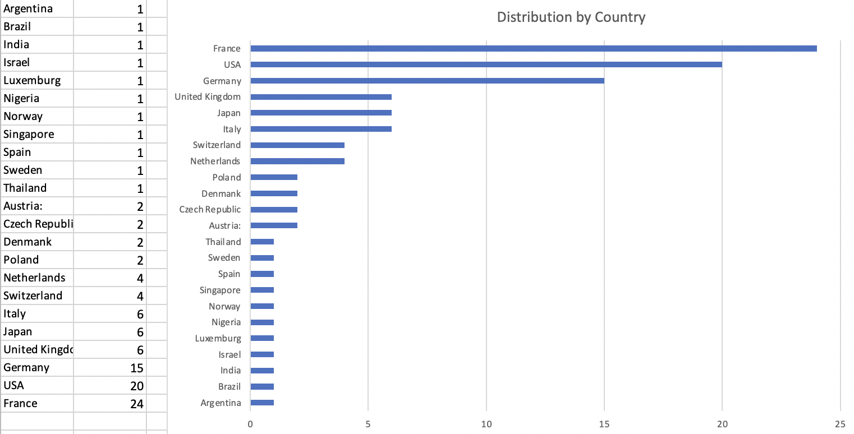
Distribution of Registrations by Country

Slide 4
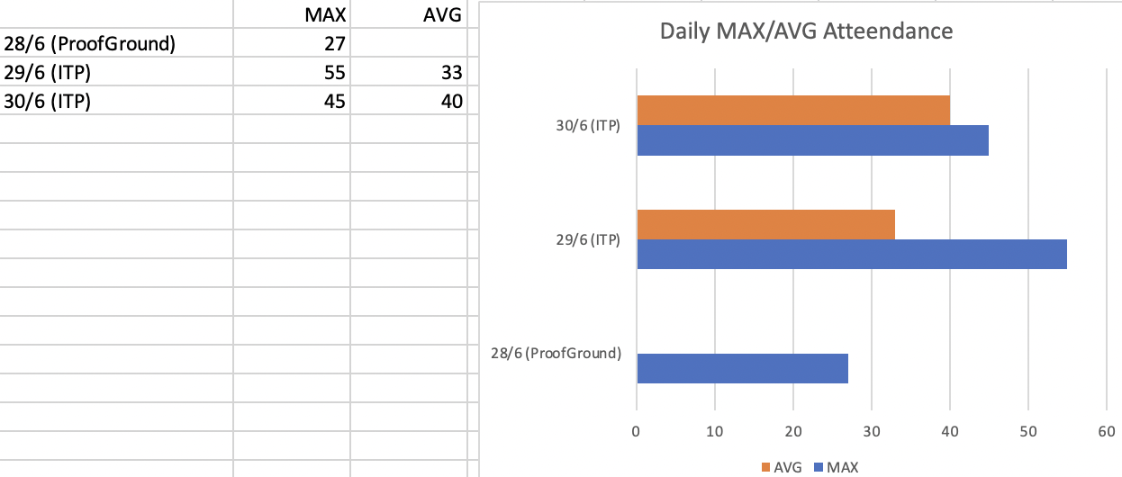
Daily Online Attendance
Social room:
Yesterday: people were passing by but no discussions were held except at one moment were we had 7 people joining and discussing for some minutes.
Today: total 10 people joined - but not at the same time

Slide 5
Acknowledgements:
Liron & Cezary, for handling all the scientific part
Kathrin Stark, for coordinating issues related to workshops
People from EasyConferences (Christos, Petros, Boyana, Evanthi, and other ones hidden behind the camera) for handling the heavy part of the organization
Thanks to the SC for having appointed me, I’d have much more preferred to physically organize in Rome
→ Maybe in the future, jus ask ;-)

